Slide 1
Information Technology Investment: Decision Making Methodology
Chapter 7
Cost/Benefit Analysis

Slide 2
Chapter Outline:
Introduction
What is Cost/Benefit Analysis?
What is Cost/Effectiveness Analysis?
Principles of Cost Benefit Analysis

Slide 3
I. Introduction
Extending the last chapter, Cost/Benefit Analysis includes ROI but also helps the decision process to consider intangible value-added benefits that are not considered in ROI.
Cost/benefit analysis may be used for ex ante (i.e., before project analysis), ex post (i.e., after project analysis) and in medias res (i.e., in progress analysis) investment evaluations

Slide 4
II. What is Cost/Benefit Analysis?
Cost/benefit analysis involves
- the estimation and evaluation of the net benefits associated with alternative courses of action
- identifying costs and benefits for each alternative investment,
- discounting the costs and benefits back to the present,
- selecting the best alternative according to a pre-specified criterion

Slide 5
II. What is Cost/Benefit Analysis?
1999~2006 National Finance Act
: More than ₩50B(Gross) or ₩30B
(Government Only)
Preliminary Feasibility Analysis
Technical
Analysis
Political Analysis
Economic Analysis

Slide 6
II. What is Cost/Benefit Analysis?
Like most methodologies, Cost/benefit analysis involves a number of steps…
Define
Problem
Identify Costs and Benefits
Quantify Costs and Benefits
Let’s examine each of these steps…
Compare
Alternatives
Perform Sensitivity Analysis

Slide 7
Step 1. Define Problem
II. What is Cost/Benefit Analysis?
- Problem definition involves an in depth analysis of the situation; investigating the needs and requirements of an IT.
- A well-defined problem includes a specification of the objectives for an IT investment and a plan to attain those objectives.
- Possible objectives for an IT investment may be improved customer service, enhanced inventory control, or better information.

Slide 8
Step 1. Define Problem
II. What is Cost/Benefit Analysis?
- This part of problem definition involves generating all possible alternative courses of action.
- Cost-benefit analysis tends to be a expensive tool. By narrowing down the number of alternatives before conducting the analysis, it is possible to better manage costs.

Slide 9
Step 2. Identify Costs and Benefits
II. What is Cost/Benefit Analysis?
- An thorough investigation should be undertaken to identify all relevant costs and benefits, and to assign dollar value to those effects.
- This includes both tangible and intangible costs and benefits. Costs for example might be some of Table 1.
- Benefits for example might be some of Table 2. Note that many of the IT benefits are intangible. Assigning a value to intangible benefit may be a very difficult, if not impossible task.

Slide 10
Step 3. Quantify Costs and Benefits
II. What is Cost/Benefit Analysis?
Several possible ways to manage intangible costs and benefits.
- One is to simply ignore them.
- Another way to manage intangibles is to conduct the cost/benefits analysis without them but list them and describe their potential effects in an addendum.
- A third way to manage intangibles is to utilize a surrogate measure for the intangible and include the effect directly into the cost/benefit analysis.
: A surrogate measure may be the value of a similar benefit or cost that is more easily assigned a value. An example might be where quality costs in a company may have traditionally be one tenth the costs of equipment.

Slide 11
Step 3. Quantify Costs and Benefits
II. What is Cost/Benefit Analysis?
- A fourth way to value an intangible is to conduct a survey to determine its value.
: Survey may be designed to measure how valuable more timely information of an IT investment is to users.
- One additional way of valuing an intangible is to use shadow prices.
: A shadow price is the value of an intangible, which indicates how much some specified index of performance could be increased by the use of a marginal unit of that intangible.

Slide 12
Step 4. Compare Alternatives
II. What is Cost/Benefit Analysis?
- Once all costs and benefits have been identified and quantified into a common unit of measure, the alternatives are then compared to one another based on a common criterion
- But before comparisons can be made, the costs and benefits that occur in subsequent time periods are often discounted back to today’s dollars.
- It is recommended that cash flows be discounted to account for this factor. Present value (PV) analysis can be used for this task.

Slide 13
Step 4. Compare Alternatives
II. What is Cost/Benefit Analysis?
The benefit/cost ratio is the present value of benefits divided by the present value of costs and is calculated as follows:

Slide 14
Step 4. Compare Alternatives
II. What is Cost/Benefit Analysis?
In summary, the four criteria are used in this way:
1. | Maximize the ratio of benefits over costs
2. | Maximize net present value of net benefits
3. | Maximize internal rate of return
4. | Shortest payback period

Slide 15
Step 4. Compare Alternatives
II. What is Cost/Benefit Analysis?
Let’s look at the use of the benefit/cost ratio from the example in the textbook:
System A | A₀ | A₁ | A₂ | A₃
Costs:
Hardware | 10,000 | 1,000 | 1,000 | 1,000
Software | 13,000 | 3,000 | 3,000 | 3,000
Services | 2,000 | 1,000 | 1,000 | 1,000
Benefits:
Increased productivity | -- | 10,000 | 6,000 | 6,000
Lower error rates | -- | 15,000 | 5,000 | 5,000

Slide 16
Step 4. Compare Alternatives
II. What is Cost/Benefit Analysis?
The costs and benefits for System B are:
System B | A₀ | A₁ | A₂ | A₃
Costs:
Hardware | 5,000 | 1,000 | 1,000 | 1,000
Software | 10,000 | 5,000 | 0 | 5,000
Services | 8,000 | 2,000 | 2,000 | 2,000
Benefits:
Increased productivity | -- | 8,000 | 10,000 | 10,000
Reduced workforce | -- | 3,000 | 5,000 | 5,000

Slide 17
Step 4. Compare Alternatives
II. What is Cost/Benefit Analysis?
The present value of costs and benefits for System A are:
 | Computer System A
Present Value of Costs
Present Value of Benefits

Slide 18
Step 4. Compare Alternatives
II. What is Cost/Benefit Analysis?
The present value of costs and benefits for System B are:
 | Computer System B
Present Value of Costs
Present Value of Benefits

Slide 19
Step 4. Compare Alternatives
II. What is Cost/Benefit Analysis?
The resulting benefit/cost ratios for both systems are:
 | Computer System A | Computer System B
Benefit/Cost Ratios
See the excel file attached

Slide 20
Step 5. Sensitivity Analysis
II. What is Cost/Benefit Analysis?
Sensitivity analysis is defined as a means of determining the reliability of the decision generated from a cost/benefit analysis
- Having the actual values of every cost and benefit associated with alternative investments would be ideal.
The values of the costs and benefits are only estimates of the true value and thus are associated with some amount of error.
Performing a sensitivity analysis is one way to determine the degree of error in the estimates.

Slide 21
Step 5. Sensitivity Analysis
II. What is Cost/Benefit Analysis?
A common way is to select costs, benefits, or other parameters in the NPV calculation, and vary them to examine their effects
- The analysis may involve selecting high and low values of a parameter and assess the effects on NPV.
The degree of dispersion of these NPVs shows how different values of a parameter affect the final NPV and corresponding decision.
Varying just one parameter may change the highest NPV of one alternative to prefer a different alternative, making the results of the analysis unreliable.

Slide 22
III. What is Cost/Effectiveness Analysis?
Cost/effectiveness analysis is another cost-analysis technique that considers costs and effects that are defined in different terms.
- In cost/benefit analysis, alternatives are evaluated based on costs and benefits measured in monetary terms.
- In cost/effectiveness analysis, costs are evaluated based on monetary terms and benefits are gauged in terms of how effectively each alternative meets a common objective. Each alternative is evaluated based on its individual costs and its contribution to meeting the same effectiveness criterion.

Slide 23
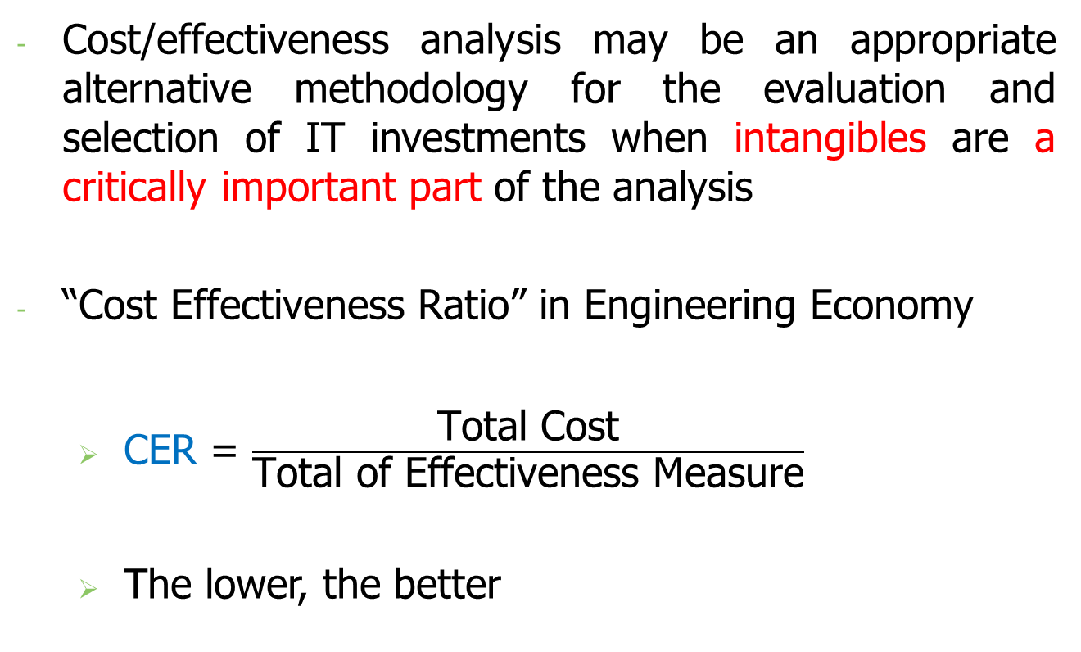
III. What is Cost/Effectiveness Analysis?
Cost/effectiveness analysis may be an appropriate alternative methodology for the evaluation and selection of IT investments when intangibles are a critically important part of the analysis
“Cost Effectiveness Ratio” in Engineering Economy
CER = $\frac{\text{Total} \text{Cost}}{\text{Total} \text{of} \text{Effectiveness} \text{Measure}}$
The lower, the better

Slide 24
VI. Principles of Cost Benefit Analysis
Pareto criteria : If at least one individual is made better off and no one is made worse off
Kaldor-hicks criteria : If those who benefit could compensate those who lose
CBA : To determine the net impact on social welfare
Among Three Groups (beneficiaries, taxpayers,
those who will be incurring losses)

Slide 25
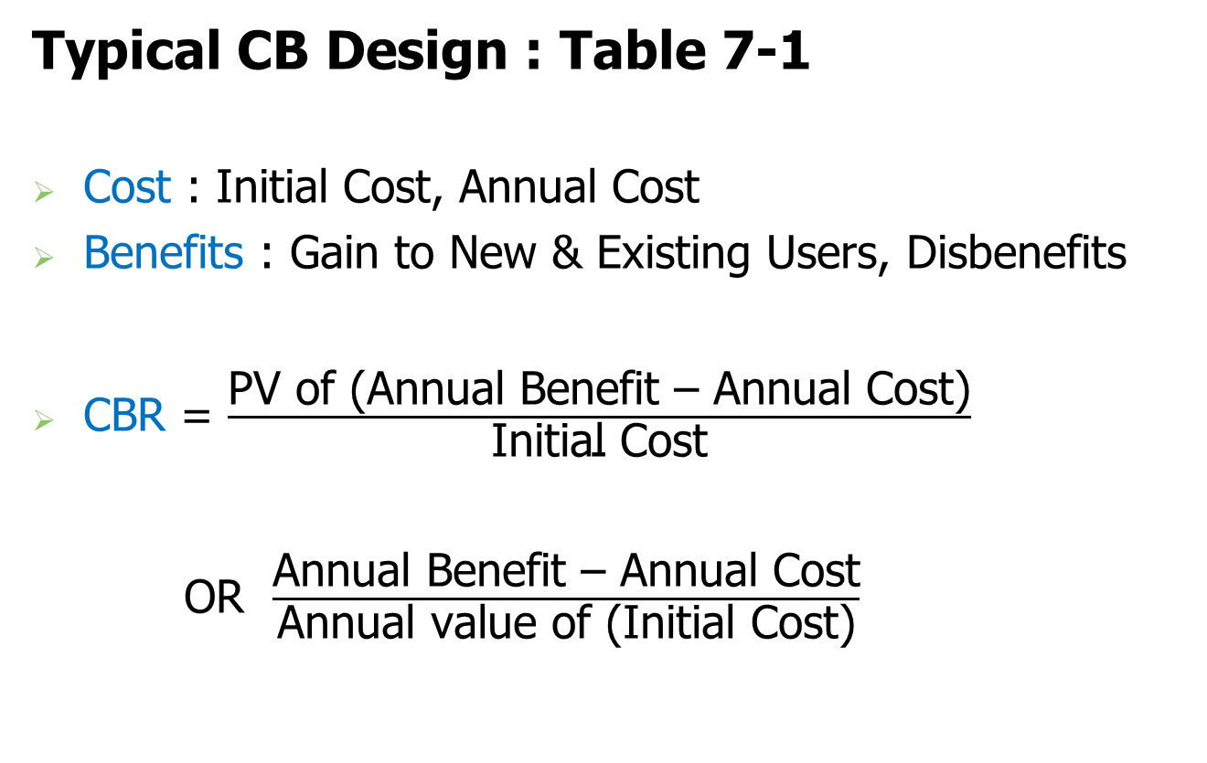
VI. Principles of Cost Benefit Analysis
Typical CB Design : Table 7-1
Cost : Initial Cost, Annual Cost
Benefits : Gain to New & Existing Users, Disbenefits
CBR = $\frac{\text{PV} \text{of}\text{ (}\text{Annual} \text{Benefit}\text{ – }\text{Annual} \text{Cost}\text{)}}{\text{Initial} \text{Cost}}$
OR $\frac{\text{Annual} \text{Benefit}\text{ – }\text{Annual} \text{Cost}}{\text{Annual} \text{value} \text{of}\text{ (}\text{Initial} \text{Cost}\text{)}}$

Slide 26
VI. Principles of Cost Benefit Analysis
Stages of CBA
Identification of Costs & Benefits
: Historical vs. Economic
: With-without Approach (Incremental changes over a baseline scenario, NOT before-after)
: Real output Effect vs. Pecuniary Effects (should avoid Double Counting)
Valuing Costs and Benefits
: How to evaluate Intangibles such as human life, time, morality, and environmental factors?

Slide 27
VI. Principles of Cost Benefit Analysis
Stages of CBA
Comparing Costs and Benefits
: Public discount rates
Project selection
: Benefit-Cost Ratios ≥ 1
: NPV ≥ 0
: IRR ≥ Public discount rate

